Slide 2
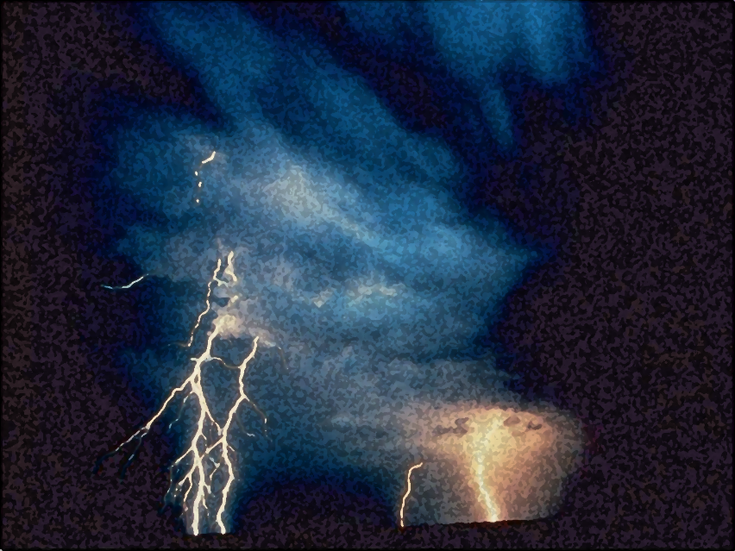
Light out of Darkness
The Vision of Isaiah
Doom to Bloom

Slide 3
The Vision of Isaiah
How to become a useful, faithful and righteous servant of God.
A Call to Servanthood

Slide 4
The Vision of Isaiah
The Problem:
What Israel Is
Versus
What Israel Will Be 2:1 – 4:6

Slide 5
The Vision of Isaiah
The Problem:
Sinful Israel
Versus
Servant Israel
2:1 – 4:6

Slide 6
The Problem
Israel has Forsaken the LORD
“I have nourished and brought up children, and they have rebelled against Me;… Israel does not know, My people do not consider… They have forsaken the LORD, they have provoked to anger The Holy One of Israel, they have turned away backward.” (1:2b, 3b, 4b)
Notes:
This is shocking statement from the “Shock Prophet” with another abrupt shift in mood.
Why has God forsaken His people? - Israel was not walking in that light but have forsaken God, therefore God has forsaken Israel.

Slide 7
The Problem
The LORD has Forsaken Israel
“Because the land is full of idols and they worship the work of their own hands.” (2:8) in a feeble attempt to exalt themselves above the LORD (2:11,17)

Slide 8
The Problem
The LORD has Forsaken Israel
The LORD will turn His hand against them and their country will be the left desolate, the land will become a wilderness, they will far by the sword, and those who remain will be removed to far away places. (1:25a, 1:7a, 27:10, 6:12)

Slide 9
The Solution
The LORD is Reasonable
“Come now, and let us reason together,… Though your sins are like scarlet, they shall be as white as snow… ‘If you are willing and obedient, You shall eat the good of the land; But if you refuse and rebel, You shall be devoured by the sword“. (1:18-20)

Slide 10
The Solution
The LORD is Merciful
“For a mere moment I have forsaken you, but with great mercies I will gather you.” (54:7)
The Forsaking is Temporary

Slide 11
The Solution
The LORD is Merciful
“You shall no longer be termed Forsaken, nor shall your land any more be termed Desolate;” (62:4)
The Forsaking is Temporary

Slide 12
The Solution
“The LORD also will be a refuge for the oppressed, a refuge in times of trouble. And those who know Your name will put their trust in You; For You, LORD, have not forsaken those who seek You.”(Psalm 9:9-10)
The Righteous are Not Forsaken

Slide 13
The Solution
“Tell the righteous it will be well with them, for they will enjoy the fruit of their deeds.” (Isa. 3:10) [NIV]
The Righteous are Not Forsaken

Slide 14
The Problem
The House of Jacob Forsaken
2:6 - 4:1
“what is”

Slide 15
The Hope
Israel Restored
4:2-6
“what will be”
“the Branch of the LORD will be beautiful and glorious”

Slide 16
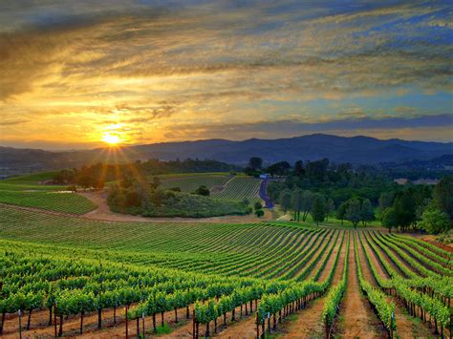
Wild Grapes
A Harvest of Wild Grapes
5:1-30
Notes:
“Chapter 5 brings the introduction to a close. Chapter 1 introduces to the Introduction, and chapter 2-4 lays bare the enormous conflict between what Israel was called to be and what, in fact, she was, Chapter 5 brings us back to the realities of Israel’s condition at the moment of Isaiah’s speaking. Whatever the future might hold, however, redemption might occur, the plain fact was that somehow present sin must be face and dealt with. No future however, such as that contained in 4:2-6, could ever obscure or obviate present evil. This message is ever the same. Yes, there in hope, but that hope cannot annihilate the present, somehow removing us from its responsibility.” Oswalt, p. 150-151.

Slide 17
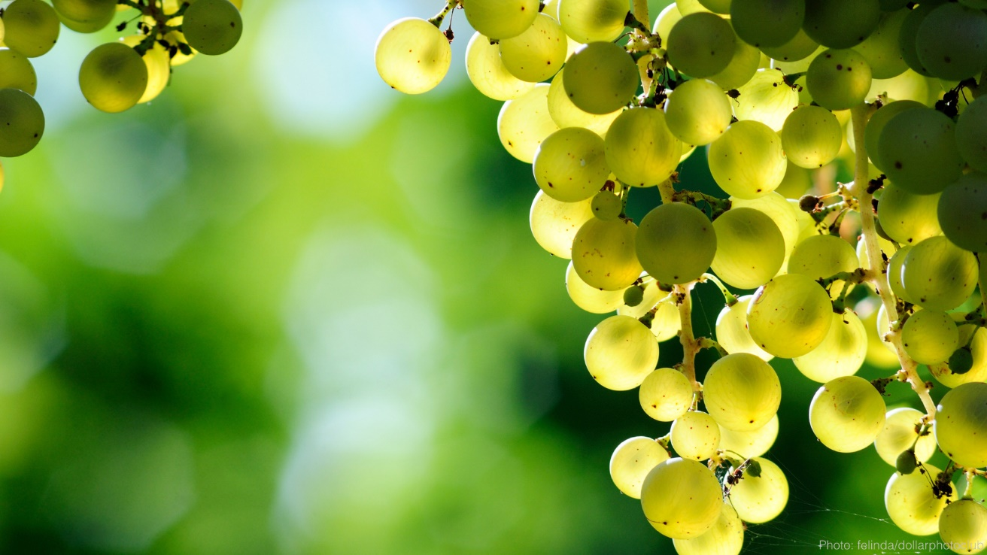
Wild Grapes
Six Conditions of Wild Grapes
Coming Destruction
Notes:
Isaiah list six conditions that exist in the people and are contrary to Gods expectations for them (8-25) and an announcement of coming destruction (5-6, 26-30) at the hands of Gentile armies.

Slide 18
Wild Grapes
The Song of the Vineyard
5:1-7
Notes:
Israel is compared to a vineyard whose owner had lavished a great deal of care upon it only to discover that the vineyard does not produce good grapes. God has cared for them, yet the fruit of their lives are bitter and sour.

Slide 19
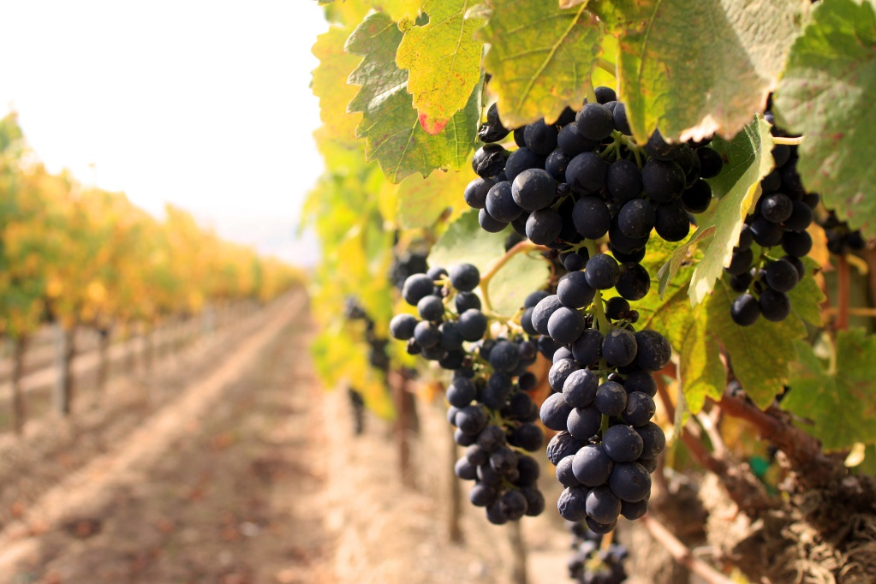
Wild Grapes
“Now let me sing to my Well-beloved A song of my Beloved regarding His vineyard:” (5:1a)
The Setting

Slide 20
Wild Grapes
“My Well-beloved has a vineyard on a very fruitful hill. He dug it up and cleared out its stones, and planted it with the choicest vine. He built a tower in its midst, and also made a winepress in it;…” (5:1b-2a)
Notes:
Isaiah calls the LORD “Well-beloved” the owner of the vineyard. Isaiah recognizes God’s awesome holiness and power, such a God could be truly adored.
This verse describes the activities of the farmer preparing his vineyard. He digs up the stones and removes them. Then the vines are planted. There will be an interval of at least two years before grapes will be produced. During this time he will build a wall and a tower from the stones he had remove from the yard. Addition facilitates were built for pressing the grapes.
What the prophet is emphasizing here is the farmer’s prior commitment He has done all this back-breaking work in expectation of receiving a crop of good grapes. The result was bitter, both in fact and spirit, for the grapes were worthless. All the hard work had been to no purpose; all the hope had been in vain.” Oswalt, p. 153

Slide 21
Wild Grapes
“So He expected it to bring forth good grapes, but it brought forth wild grapes.” (5:2b)
The Setting

Slide 22
Wild Grapes
“And now, O inhabitants of Jerusalem and men of Judah, Judge, please, between Me and My vineyard. What more could have been done to My vineyard that I have not done in it?” (5:3-4a)

Slide 23
Wild Grapes
“Why then, when I expected it to bring forth good grapes, did it bring forth wild grapes?” (5:4b)
The Verdict
Notes:
The inhabitance of Jerusalem and Judea would be able to render the verdict themselves – “nothing”.

Slide 24
Wild Grapes
“And now, please let Me tell you what I will do to My vineyard: (5:5a)
The Announcement of the Owner’s Decision
Notes:
Isaiah wants them to have no doubt as to what the owner will do. He will not merely abandon his worthless vineyard, he will also assist in its destruction.

Slide 25
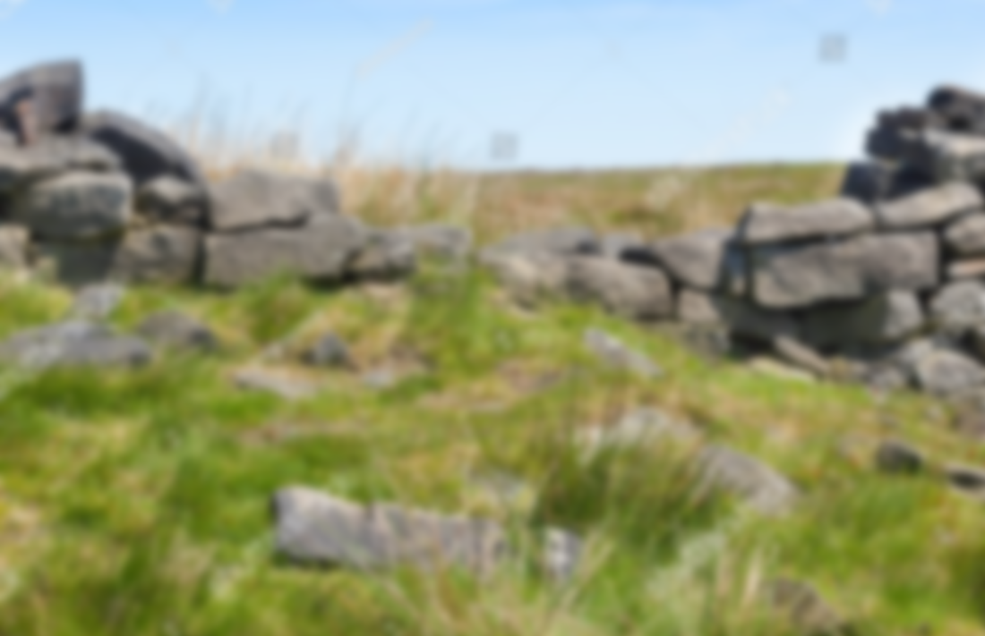
Wild Grapes
“I will take away its hedge, and it shall be burned; And break down its wall, and it shall be trampled down.” (5:5b)
Notes:
The hedge is the thorns that has grown over the wall. And he will remove the wall leaving it unprotected from the animals.

Slide 26
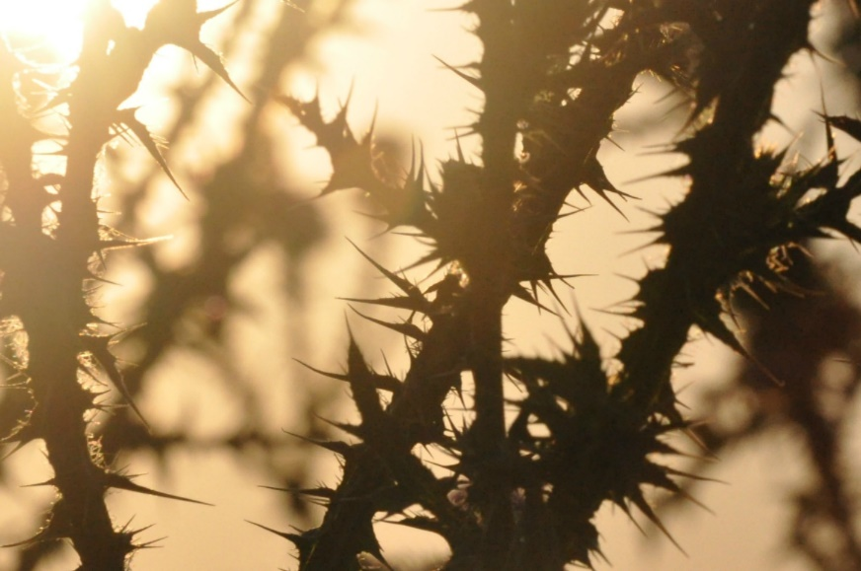
Wild Grapes
“I will lay it waste; It shall not be pruned or dug, but there shall come up briers and thorns. I will also command the clouds that they rain no rain on it.” (5:6)

Slide 27
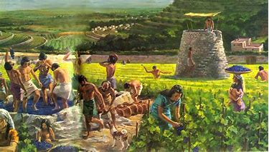
Wild Grapes
“For the vineyard of the LORD of hosts is the house of Israel, and the men of Judah are His pleasant plant…” (5:7a)
The Application
Notes:
The vineyard is Israel, the source of God’s delight and the object of His desire.

Slide 28
Wild Grapes
“He looked for justice, but behold, oppression; For righteousness, but behold, a cry for help.” (5:7b)
The Application
Notes:
Yet the fruit of God’s labor is not the justice and righteousness he had worked for, but instead oppression and violence.

Slide 29
Wild Grapes
Woe to
Wild Grapes
5:8-25
Greed and Indulgence
5:8-17

Slide 30
Wild Grapes
“Woe to those who join house to house; They add field to field, till there is no place where they may dwell alone in the midst of the land!” (5:8)
Greed and Indulgence
Notes:
“Woe” – “hoy” – It was a lament as much as a threat. The prophet is not merely angry and denunciatory, but is also grief-stricken over the sins of the people. The laments are twice broken by “double therefore”, the consequences of their sin.
“The problem Isaiah is address is the emergence of a wealthy land class which turned its attention more and more to pleasure and indulgence…. Isaiah accuses the landgrabbers of wanting to possess everything in sight until they could live by themselves in their own little world.” (p. 159)
“…the twin instincts of gathering and squandering have been the sole possessions of Judah or Israel. Around the world people are driven by the desire to posses more and more and then spend what they possess more and more lavishly, but only to please themselves.” (Oswalt, p. 158)
According to the Law all the land belong to God and allowed families to possess parcels of that land, it was not theirs to do with it as they pleased. It had to be kept in the family. If a family did lose their land, it had to be automatically returned to in the year of Jubilee (50th year). Israel had ignored the law and the 10th commandment and those who had the means were dispossessing the poor and reducing them to servitude on their own land.
Paul sees covetousness as being at the heart of idolatry – placing ultimate value in things of this world.
Jesus said, “What shall it profit a man if he gains the whole world and lose his own life?” (Matt. 16:26)

Slide 31
Wild Grapes
“In my hearing the LORD of hosts said, ‘Truly, many houses shall be desolate, great and beautiful ones, without inhabitant. For ten acres of vineyard shall yield one bath, and a homer of seed shall yield one ephah.” (5:9-10)
The Consequence
Notes:
But in the final analysis covetousness is self-defeating and self-destructive. “To acquire is to lose, to give is to get.”

Slide 32
Wild Grapes
“For whoever desires to save his life will lose it, but whoever loses his life for My sake will find it.” (Matt. 16:25 )
“to get is to lose”, but
to give is to get”

Slide 33
Wild Grapes
“Woe to those who rise early in the morning, that they may follow intoxicating drink; Who continue until night, till wine inflames them! The harp and the strings, the tambourine and flute, and wine are in their feasts;” (5:11-12a)
Debauchery
Notes:
Isaiah continues to address the wealthy who by their abundance spend the entire day, from early morning to late at night pursuing their own pleasure, particularly drinking (drugs). He does not oppose pleasure because it is wrong in itself but because they have become all-absorbing.

Slide 34
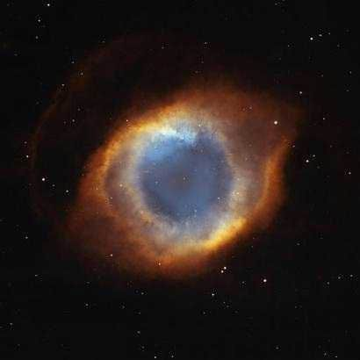
Wild Grapes
“But they do not regard the work of the LORD, nor consider the operation of His hands.” (5:12b)
Dimwitted
Notes:
“…they have become so self-absorbing to the point where spiritual sensitivity has become dimmed. The revealers no longer have any interest in the ability to recognize how God is at work in the world. When the passions for pleasure has become uppermost in a persons life, passion of God and his truth and his ways is squeezed out. The use of drugs and alcohol in the quest for pleasure can only heighten the degree to which one becomes insensitive to responsibility and vales.” Oslwald, p. 160.

Slide 35
Wild Grapes
“Give me neither poverty nor riches -- Feed me with the food allotted to me; Lest I be full and deny You, and say, ‘Who is the LORD?” (Prov. 30:8-9)
Dimwitted

Slide 36
Wild Grapes
“Therefore my people have gone into captivity, because they have no knowledge; Their honorable men are famished, and their multitude dried up with thirst.” (5:13)
The Consequence
Notes:
What is the result of arduous pursuit of property and pleasure? God’s people must leave the land.
From the beginning their particular destiny and privilege has been to know God, but evidently do not know Him. “What they did not have was the experiential relationship with God that gave life to his commandments and meaning to what he was doing in the world.” (p. 160) It is true even today that vast majority of people lack any overarching view of God’s purposes. If people would only read this book – Isaiah that would change.
However the drunken people simply do not perceive what God is about in his world, and what he is about includes the establishment of justice and righteousness, and love… as much as it does retribution upon stubborn human arrogance.” (p. 161)

Slide 37
Wild Grapes
“Therefore Sheol has enlarged itself and opened its mouth beyond measure; Their glory and their multitude and their pomp, and he who is jubilant, shall descend into it.” (5:14)
The Consequence
Notes:
As a result of their lack of perception the noble and the not so noble will all be deprived of the necessities of life, death will swallow them all up together. “All attempts to gain pride and power reach the same level in the grave.”

Slide 38
Wild Grapes
“People shall be brought down, each man shall be humbled, and the eyes of the lofty shall be humbled.” (5:15)
The Consequence
Notes:
Human pride has everything to do with the quest for pleasure. It is pride which drives a person to possess more,… and to seek more and more exotic entertainment which will set one off from the crowd. And because the rich and mighty give themselves to these endless pursuits rather to the knowledge of God, the whole nation will go down to the grave together.” (p. 162)

Slide 39
Wild Grapes
“But the LORD of hosts shall be exalted in judgment, and God who is holy shall be hallowed in righteousness.” (5:16)
The Consequence
Notes:
This verse expresses the truth that what makes God truly God, what sets him off as divine, is His essential justice and righteousness. And these characteristics are what eventually humiliates all human beings in His presence, our inability to love justice and do rightly. Justice and righteousness is what marks God as truly holy, that which makes God truly unique. It is his moral nature that sets Him apart.
In order for Israel to become what they ought to be, the servants to the living God, then they will have to begin to on the self-deny choice of a just and upright life. (Micah 6:6-8)

Slide 40
Wild Grapes
“With what shall I come before the LORD, and bow myself before the High God?... He has shown you, O man, what is good; And what does the LORD require of you but to do justly, to love mercy, and to walk humbly with your God?” (Micah 6:6-8)

Slide 41
Wild Grapes
“Then the lambs shall feed in their pasture, and in the waste places of the fat ones strangers shall eat.” (5:17)
The Consequence
Notes:
What is the end result of Israel and man’s humiliation? Instead of music, dancing, the light and the glitter, laughter and pomp is the silence of the lambs.

Slide 42
Wild Grapes
Woe to
Wild Grapes
5:8-25
Cynicism and Perversion
5:18-25

Slide 43
Wild Grapes
“Woe to those who draw iniquity with cords of vanity, and sin as if with a cart rope; That say, ‘Let Him make speed and hasten His work, that we may see it; And let the counsel of the Holy One of Israel draw near and come, that we may know it.” (5:18-19)
Notes:
Humanity doubts that God is really active in the world and they imagine that they are better able to determine what is really right and wrong than he is. The result is a perversion where values are reversed, debauchery is more honorable that courage drunkenness is preferred to sobriety, wicked are pronounced innocent, while the righteous are condemned. For such a vineyard another double therefore of destruction is promised.
So intoxicated with the quest for pleasure they have become insensitive to the work of God in the world. They call out in a mocking fashion for Isaiah’s God to hurry up and get his work out where they can see it. “I believe it when I see it”. They are daring God to punish them for the conscious choice of choosing evil and exerting concentrated effort to make that choice. They are not sinning out a mistake or ignorance, they have not fallen into sin, but are pulling on it.

Slide 44
Wild Grapes
“Woe to those who call evil good, and good evil; Who put darkness for light, and light for darkness; Who put bitter for sweet, and sweet for bitter!” (5:20)
Perversion
Notes:
“In order to justify their behavior, they must, in the most sophisticated reasoning possible, demonstrate that their evil behavior is good, and their darkness is light, and their bitterness is sweet. This attitude is the end result of refusal to admit the absolute authority of a revealed Word.” (p. 165)

Slide 45
Wild Grapes
“Woe to those who are wise in their own eyes, and prudent in their own sight!” (5:21)
Perversion
Notes:
“Self-interest will press reason into service to justify its own behavior.” (p. 165)

Slide 46
Wild Grapes
“Woe to men mighty at drinking wine, Woe to men valiant for mixing intoxicating drink, who justify the wicked for a bribe, and take away justice from the righteous man!” (5:22-23)
Injustice
Notes:
This is a graphic summary of the points made about human arrogance and pride. “Here are picture the great men of the nation, who are only great behind the bar, mixing drinks. However, when they are charge to judge a case they can be depended upon freeing the guilty (OJ Simpson) and convicting the innocent – if the price is right.
Hillary – accused of operating an illegal email server in the bathroom of her home, whitewashing the evidence, requiring people to pay to play, approving the sell uranium to the Russians in exchange for a elaborate speaking fee from her husband, and now paying for false stories about an candidate of the opposing party, accusing him of the very thing that she was doing.

Slide 47
Wild Grapes
“Therefore, as the fire devours the stubble, and the flame consumes the chaff, so their root will be as rottenness, and their blossom will ascend like dust; (5:24a)
The Consequence
Notes:
There is nothing to do with the vineyard except to destroy it.

Slide 48
Wild Grapes
“Because they have rejected the law of the LORD of hosts, and despised the word of the Holy One of Israel.” (5:24b)
The Consequence

Slide 49
Wild Grapes
“Therefore the anger of the LORD is aroused against His people; He has stretched out His hand against them and stricken them, and the hills trembled. (5:25a)
The Consequence
Notes:
It is because Israel had rejected God’s Law and the word of her Holy One that God has already began to act in judgement.

Slide 50
Wild Grapes
“Their carcasses were as refuse in the midst of the streets. For all this His anger is not turned away, but His hand is stretched out still.” (5:25b)
The Consequence

Slide 51
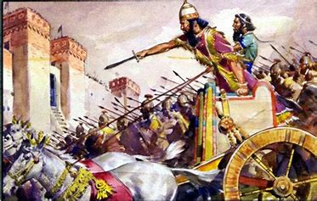
Wild Grapes
Coming Destruction
5:26-30

Slide 52
Wild Grapes
“He will lift up a banner to the nations from afar, and will whistle to them from the end of the earth; Surely they shall come with speed, swiftly.” (5:26)
Notes:
The nations are but a instrument in the LORD’s hands. The great armies sweeping the world in the 5th century BC were not the shapers of the world’s destiny but were themselves shaped by the One who holds all things. It is upon His signal that they rise and move; at His whistle they come out of their hive like bees to do His bidding.” (p. 169)

Slide 53
Wild Grapes
“No one will be weary or stumble among them, no one will slumber or sleep; Nor will the belt on their loins be loosed, nor the strap of their sandals be broken; Whose arrows are sharp, and all their bows bent; Their horses' hooves will seem like flint, and their wheels like a whirlwind.” (5:27-28)
Notes:
Vs. 27 shows what is not the case and vs. 28 shows what is the case.

Slide 54
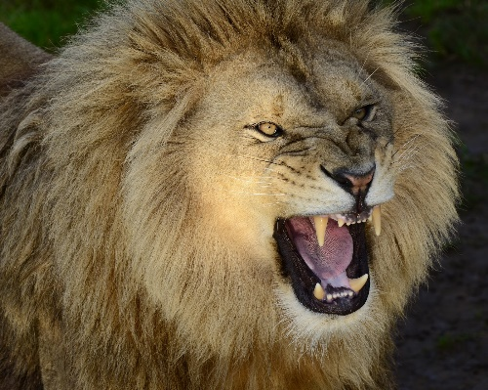
Wild Grapes
“Their roaring will be like a lion, they will roar like young lions; Yes, they will roar and lay hold of the prey; They will carry it away safely, and no one will deliver.” (5:29)

Slide 55
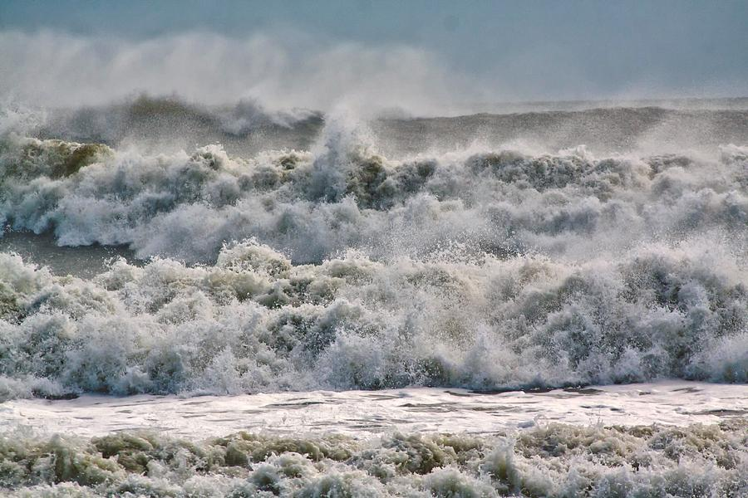
Wild Grapes
“In that day they will roar against them like the roaring of the sea. And if one looks to the land, Behold, darkness and sorrow; And the light is darkened by the clouds.” (5:30)
Notes:
Hope is gone, darkness and distress fill the land, the light of day is even obscured by the dark clouds of battle.

Slide 56
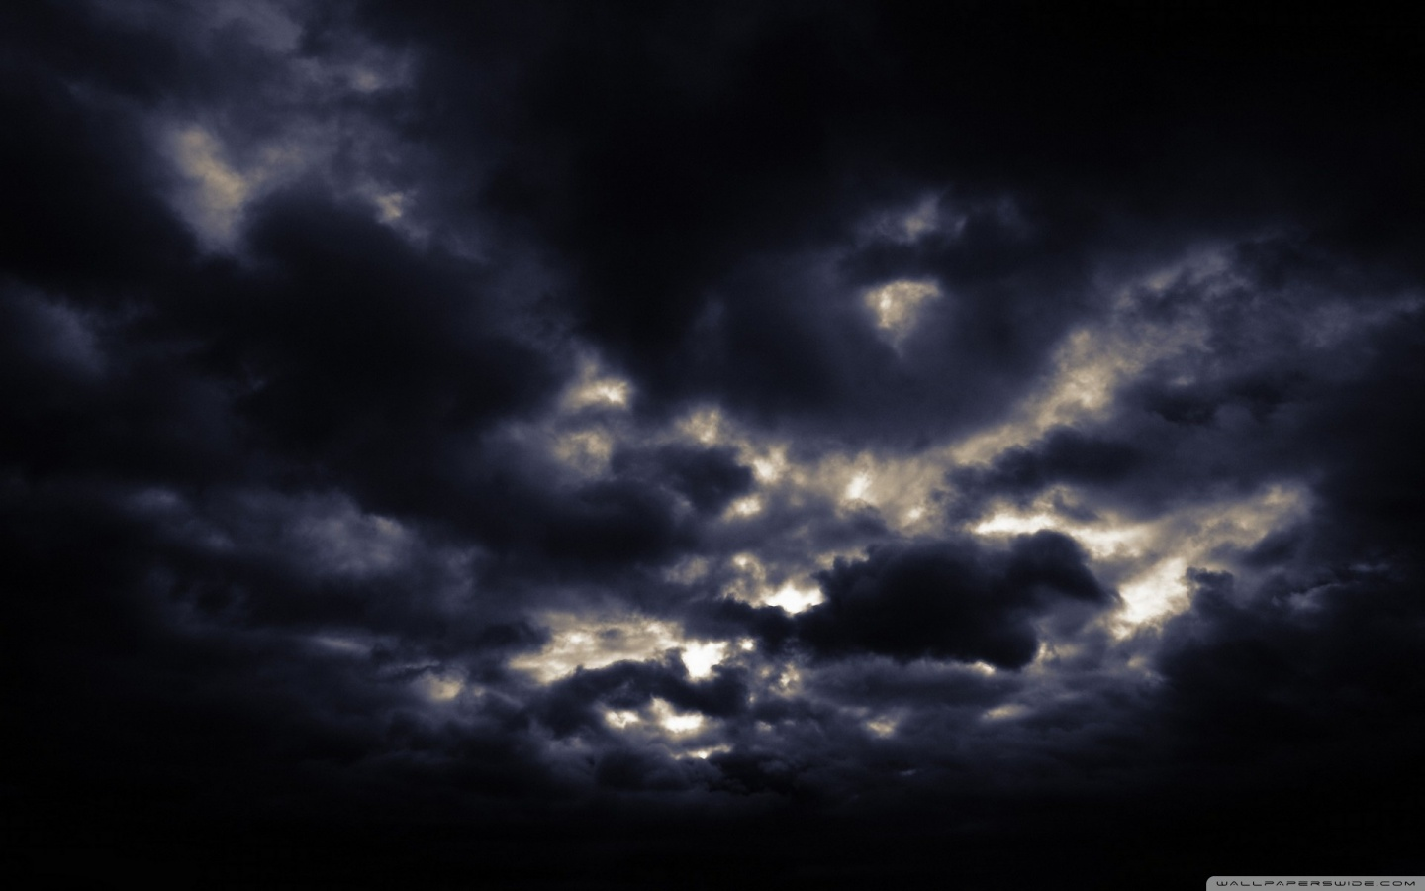
Wild Grapes
“In that day they will roar against them like the roaring of the sea. And if one looks to the land, Behold, darkness and sorrow; And the light is darkened by the clouds.” (5:30)

Slide 57
The Vision of Isaiah

